Slide 1
Learning & Development Enabling development, Impacting growth…
BIG-04
HBase – Module 10

Slide 2
Module Outline
What is HBase?
When To Use HBase?
HBase Data Model
HBase Logical View
HBase Physical Model
Major Components Of HBase
HBase Big Picture
Compaction
HBase Shell
HBase Useful Commands
Hand’s On

Slide 3
What Is HBase?
HBase is a distributed column-oriented data store built on top of HDFS
HBase is an Apache open source project whose goal is to provide storage for the Hadoop Distributed Computing
Data is logically organized into tables, rows and columns
HBase is . . .
Open-Source
Sparse
Multidimensional
Persistent
Distributed
Sorted Map
Runs on top of HDFS
Modeled after Google’s BigTable

Slide 4
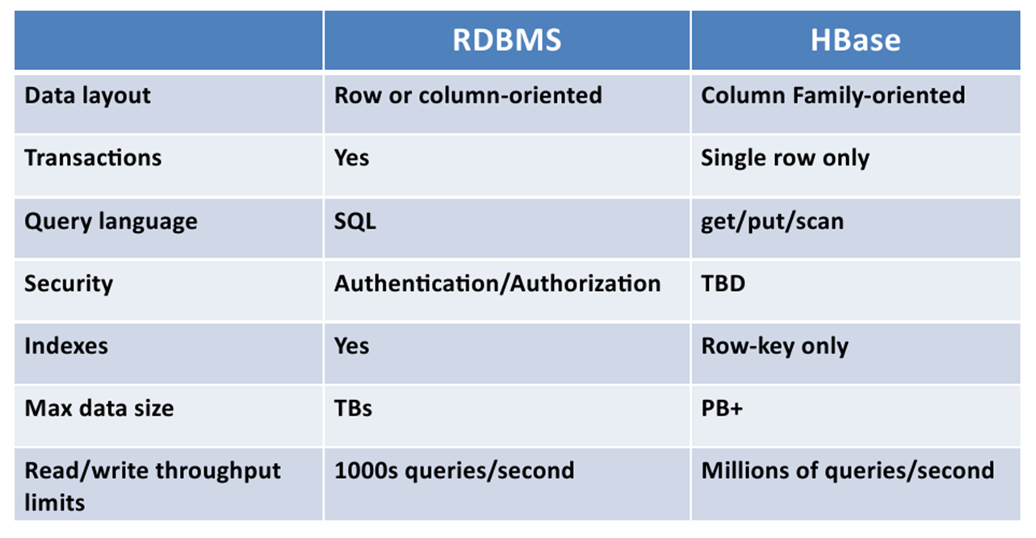
HBase Is Not a Traditional Database

Slide 5
When To Use HBase?
Use HBase if…
You need random write, random read, or both (but not neither)
You need to do many thousands of operations per second on multiple TB of data
Your access patterns are well-known and simple
Don’t use HBase if…
You only append to your dataset, and tend to read the whole thing
You primarily do ad-hoc analytics (ill-defined access patterns)
Your data easily fits on one beefy node

Slide 6
HBase Data Model
Overview
Tables are made of rows and columns
Every row has a row key (analogous to a primary key)
Rows are stored sorted by row key for fast lookups
All columns in HBase belong to a particular column family
A table may have one or more column families
Common to have a small number of column families
Column families should rarely change
A column family can have any number of columns
Table cells are versioned, un-interpreted arrays of bytes

Slide 7
HBase Data Model (Cont …..)
HBase is based on Google’s Bigtable model
Key-Value pairs

Slide 8
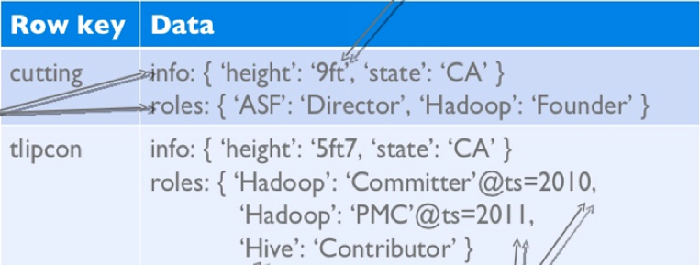
HBase Data Model (Cont …..)
HBase schema consists of several Tables
Each table consists of a set of Column Families
Columns are not part of the schema
HBase has Dynamic Columns
Because column names are encoded inside the cells
Different cells can have different columns
“Roles” column family has different columns in different cells

Slide 9
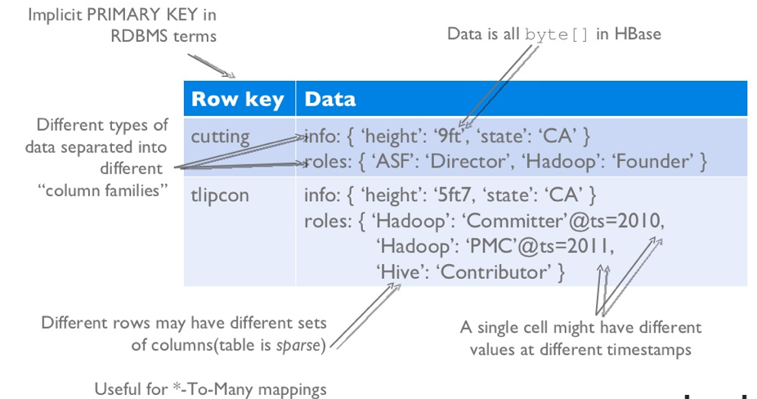
HBase Logical View

Slide 10
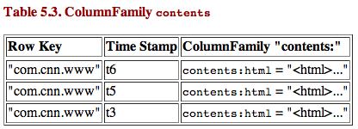
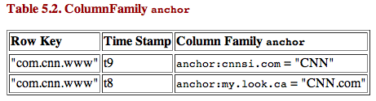
HBase Physical Model
Each column family is stored in a separate file (called HTables)
Key & Version numbers are replicated with each column family
Empty cells are not stored
HBase maintains a multi-level index on values:
<key, column family, column name, timestamp>

Slide 11
Three Major Components Of HBase
The HBaseMaster
One master
The HRegionServer
Many region servers
The HBase client

Slide 12
HBase Components
Region
A subset of a table’s rows, like horizontal range partitioning
Automatically done
RegionServer (many slaves)
Manages data regions
Serves data for reads and writes (using a log)
Master
Responsible for coordinating the slaves
Assigns regions, detects failures
Admin functions
Zookeeper
A centralized service used to maintain configuration information and service for HBase
Catalog Tables
Keep track of the locations of Region Servers and Regions

Slide 13
HBase Components -- HMaster
Responsible for coordinating the slaves (HRegionServers)
Assigns regions, detects failures of HRegionServers
Handles schema changes
Master runs several background threads
LoadBalancer Periodically reassigns Regions in the cluster
CatalogJanitor periodically checks and cleans up the .META.Table
Can have multiple Masters
Upon startup all compete to run the cluster
If the active Master loses its lease in Zookeeper then the remaining Masters compete for the Master role

Slide 14
HBase Components -- HRegion Servers
Serve data for reads and writes of rows contained in Regions
Also will split a Region that has become too large
Interface Methods exposed by HRegionRegionInterface
Data Methods, Region Methods
Get, put, delete, next, etc.
splitRegion, compactRegion, etc.
Runs several background threads
CompactSplitThread check for splits,handle minor compactions
MajorCompactionChecker checks for major compactions
MemStoreFlusher periodically flushes in-memory writes in the
MemStore to StoreFiles.
LogRoller periodically checks the RegionServer's HLog

Slide 15
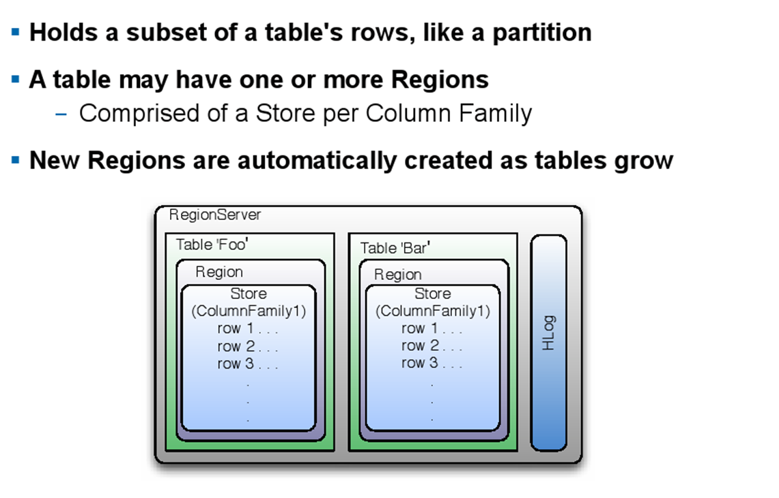
HBase Components -- Regions

Slide 16
HBase Components -- Zookeeper And Catalog
Zookeeper Service
Stores global information about the cluster
Provides synchronization and detects Master node failure
Holds the location of the -ROOT- table and the Master
Catalog
ROOT- Catalog Table
A table that lists the location of the .META. table(s)
The following is an example of: scan ‘-ROOT-’!
.META. Catalog Table
A table that lists all the regions and their locations
The following is an example of: scan ‘.META.’!

Slide 17
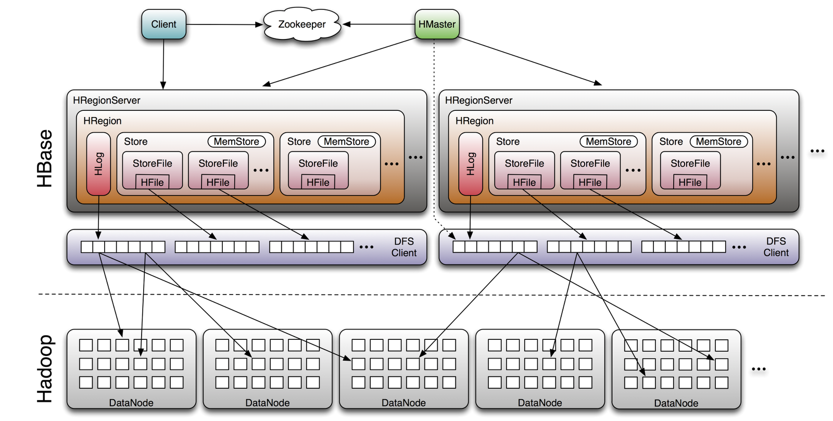
HBase Big Picture

Slide 18
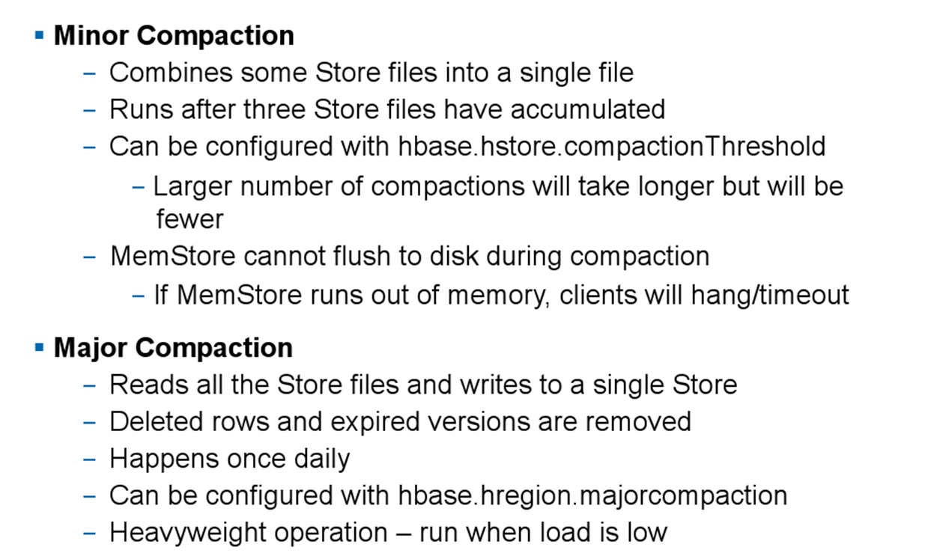
Compaction

Slide 19
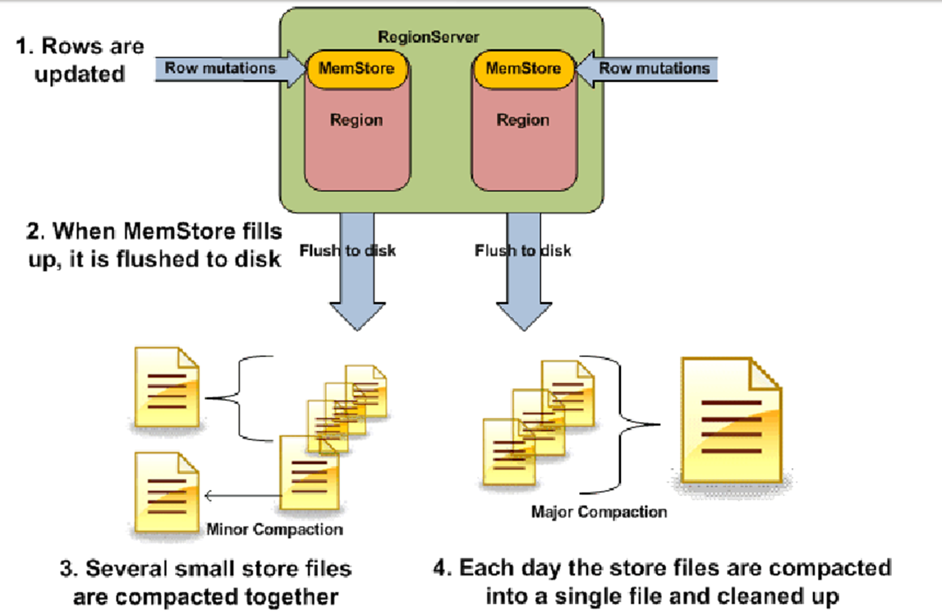
Compaction Continue…..

Slide 20
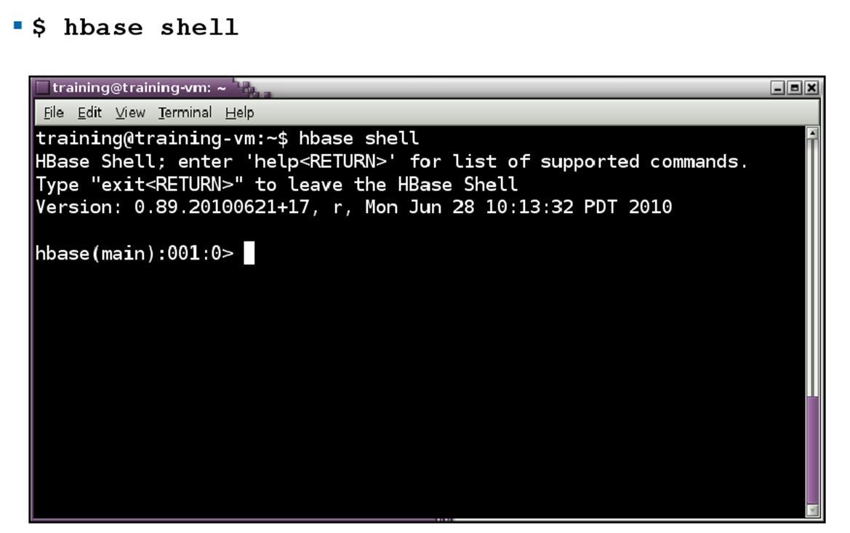
Running HBase Shell

Slide 21
HBase – Useful Commands
Help
Lists all the shell commands
Status
Shows basic status about the cluster
List
Lists all user tables in HBase
describe '<tablename>‘
Returns the structure of the table

Slide 22
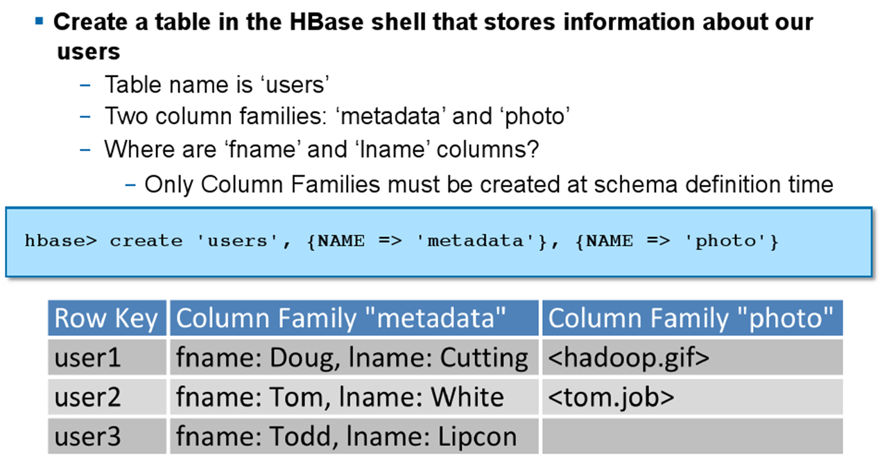
Create Table
create '<tablename>' ,{NAME => '<colfam>' [, <options>]} [,{…}]
create 't1', {NAME => 'fam1'}
create 't1', {NAME => 'fam1', VERSIONS => 1}
create 't1', {NAME => 'fam1'}, {NAME => 'fam2'}
Shorthand: create 't1', 'fam1', 'fam2'

Slide 23
Create Table --- Java API
HBaseAdmin admin= new HBaseAdmin(config);
HColumnDescriptor []column;
column= new HColumnDescriptor[2];
column[0]=new HColumnDescriptor("columnFamily1:");
column[1]=new HColumnDescriptor("columnFamily2:");
HTableDescriptor desc= new HTableDescriptor(Bytes.toBytes("MyTable"));
desc.addFamily(column[0]);
desc.addFamily(column[1]);
admin.createTable(desc);

Slide 24
Accessing Data In Tables
Get
get '<tablename>', '<rowkey>' [,options]
– get 't1', 'r1'
– get 't1', 'r1', {COLUMN => 'fam1:c1'}
– get 't1', 'r1', {COLUMN => 'fam1:c1', VERSIONS=> 2}
Put
put '<tablename>', '<rowkey>', '<colfam>:<col>',
'<value>' [,timestamp]
– put 't1', 'r1', 'fam1:c1', 'value'
– put 't1', 'r1', 'fam1:c1', 'value', 1274302629663

Slide 25
Scan And Count
Scan:
scan '<tablename>' [,{<options>}]
– May include options for COLUMNS, START/STOP ROW,
TIMESTAMP or COLUMNS
– scan 't1'
– scan 't1', {COLUMNS => 'fam1:c1'}
– scan 't1', {COLUMNS => 'fam1:'}
– scan 't1', {STARTROW => 'r1', LIMIT => 10}
Count :
count '<tablename>' [, interval]
– count 't1', 5000

Slide 26
Removing Data And Tables
Delete columns in a row
– delete '<tablename>', '<row key>', '<col>'
– delete 't1', 'r1', 'fam1:c1'
Delete an entire row
– deleteall '<tablename>', '<row key>'
– deleteall 't1', 'r1'
Delete all the rows
– truncate '<tablename>‘
disable '<tablename>‘
drop '<tablename>‘
major_compact '.META.’

Slide 27
Changing Column Families
Delete columns in a row
– delete '<tablename>', '<row key>', '<col>'
– delete 't1', 'r1', 'fam1:c1'
Delete an entire row
– deleteall '<tablename>', '<row key>'
– deleteall 't1', 'r1'
Delete all the rows
– truncate '<tablename>‘
disable '<tablename>‘
drop '<tablename>‘
major_compact '.META.’

Slide 28
Q & A

Slide 29
Thank You
Review Date | 15-July-2015
Version | 1.0
Next Review Due | 15-July-2016

